Slide 1
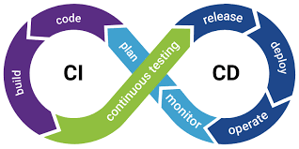
Introduction To CI/CD

Slide 2

What is
CI/CD?
CONTINUOUS INTEGRATION
CI, short for Continuous Integration, is a software development practice in which all developers merge code changes in a central repository multiple times a day
With CI, each change in code triggers an automated build-and-test sequence for the given project, providing feedback to the developer(s) who made the change.
CONTINUOUS DELIVERY/DEPLOYMENT
CD stands for Continuous Delivery/Deployment, which on top of Continuous Integration adds the practice of automating the entire software release process. Continuous Delivery includes infrastructure provisioning and deployment, and all these processes are fully automated.

Slide 3
What is CI/CD?
CI
Push the code to a VCS (like GitHub)
The build server checks the code as soon as it is pushed
Devs gets the feedback (passed/failed)
Code get packaged and stored in a repository
CD
Ensure that the software can be released reliably
Deployments are quick and often
Helps in automated deployment

Slide 4
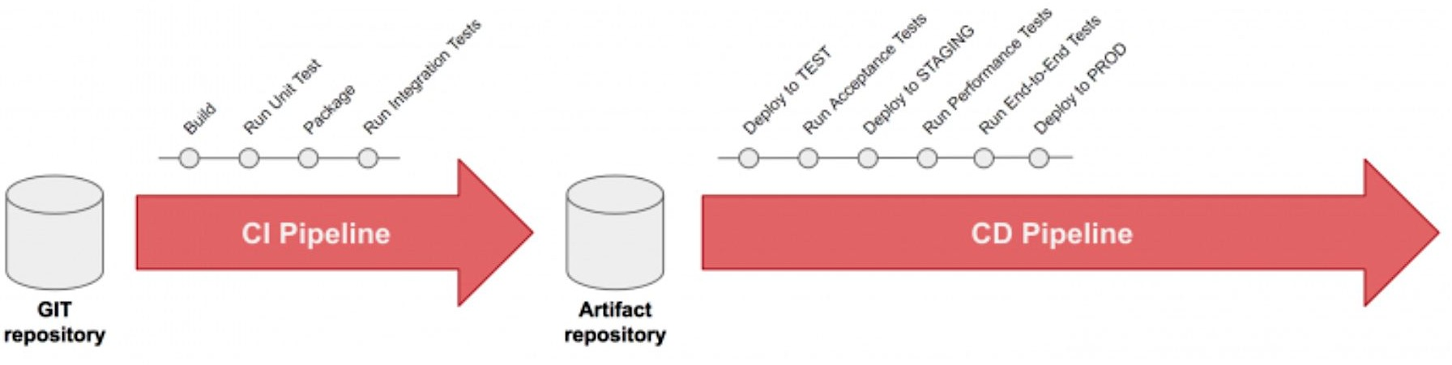
What is CI/CD?

Slide 5
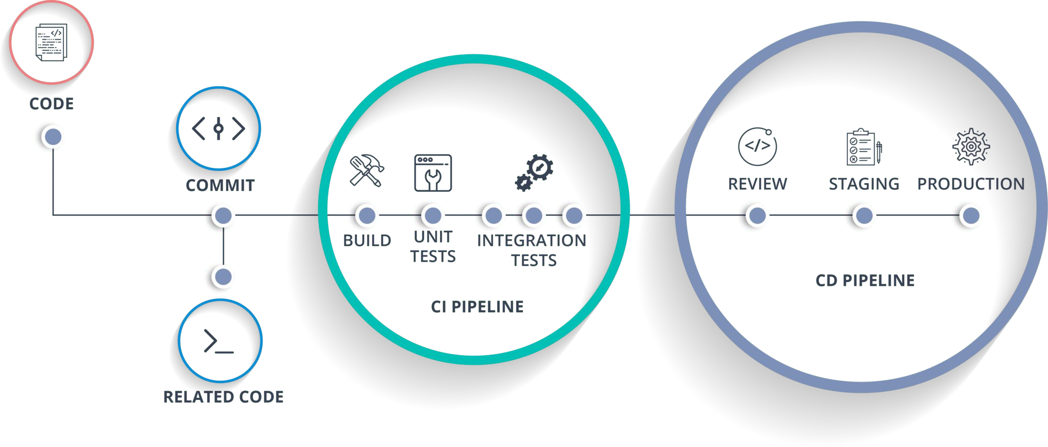
Why CI/CD?
Smaller Code Changes
Continuous Testing
Early Fault Detections
Faster Release Rate
Customer Satisfaction
Easy Maintenance and Updates

Slide 6
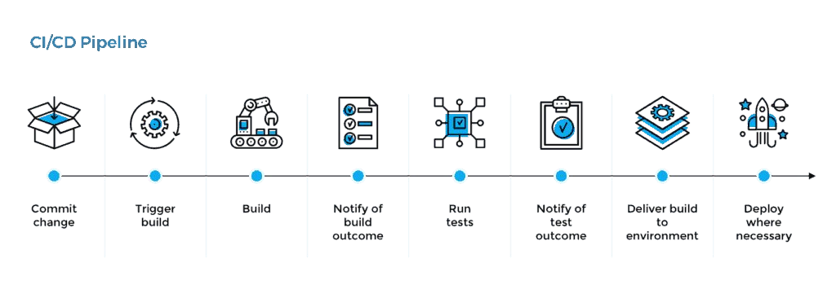
CI/CD Lifecycle

Slide 7
Continuous Delivery v/s Continuous Deployment
Continuous Delivery
Ability to deploy often using automation
Involves a manual step to “approve” a deployment
Deployment is still automated and repeated
Continuous Deployment
Full automation
Code Changes deployed all the way to Production
No manual intervention of approvals

Slide 8
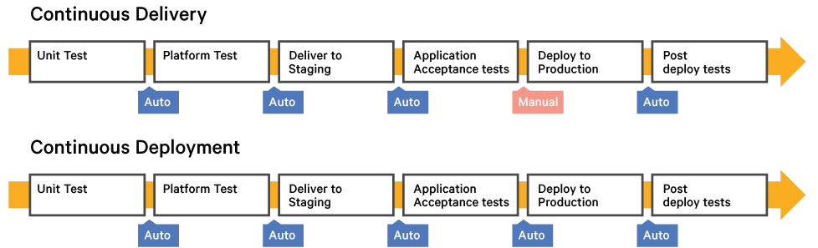
Continuous Delivery v/s Continuous Deployment

Slide 9
CI & CD pipelines using Jenkins
What is Jenkins
The leading open source automation server.
Jenkins provides hundreds of plugins to support building, deploying and automating any project.
Enables developers around the world to reliably build, test, and deploy their software.

Slide 10



Thank You!

